Slide 2
Inetra on the IT market since 2004
We create:
Mobile applications
Web services
SmartTV Apps
Android TV Apps
EXPERTISE:
Telecom Solutions, OTT Services, TV Channels
Internal systems for business
Solving business problems: unique products, market launch, development cost optimization
Software development for most platforms
Building processes
They say about us:
https://habr.com/ru/post/483886/
http://yamobi.ru/posts/coworking_prostor.html
http://yamobi.ru/posts/peerstv-inetra.html
https://www.youtube.com/watch?v=59iIErEvaeQ

Slide 3
Developments of Inetra
OWN PRODUCTS:
МЛК
Cross-platform TV service for web, iOS, Android, Smart TV and set-top boxes. TV online and recorded.
Effective solution to reduce
media content delivery costs.
An application for subscribers that allows you to manage the provider's services from mobile devices.

Slide 4
Developments of Inetra
DEVELOPMENT TO ORDER:
One-click outdoor advertising management. Platform for placing digital outdoor advertising
Website for ER-Telecom customers. Allows you to watch TV and VOD content.
Android set-top box for customers of ER-Telecom operator. Watching TV and VOD content.
Fundamentally new set-top box from Novosibirsk operator with a unique interface
Peersay.
Voice remote
CRM
My bills
My house
Convenient service for paying utility bills using a smartphone
User application for monitoring the state of the house and controlling visits of guests
Mobile app
for TV management
by voice
We are developing an internal system for the work of employees of a real estate agency
UpstreamLab
Corporate system for the work of specialists in the oil industry
Helper for food selection in UK
Lecture-bar for events and meetings
Coworking where you can work productively, develop and find like-minded people

Slide 5
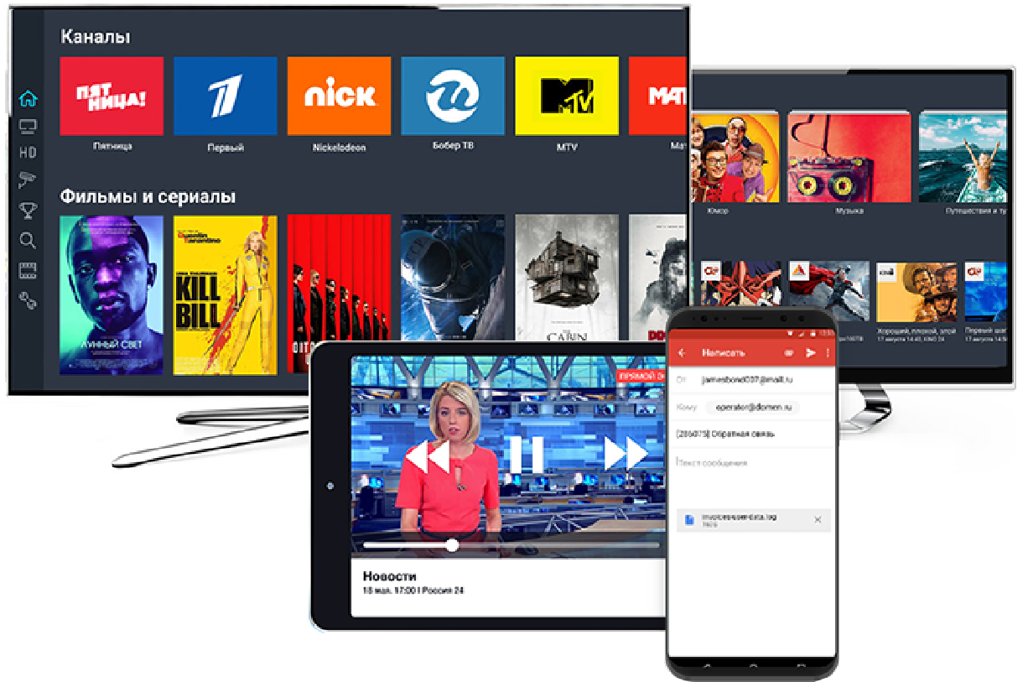
Peers.TV
CROSS-PLATFORM SOLUTION
Peers.TV service is available on all popular platforms, the list of which is continuously expanding: Web, iOS, Android, Smart TV, STB.

Slide 6
Peers.TV
HLS-broadcasting
CDN for media content
Traffic saving system "ByteFog"
Voice search and broadcast management
Integration and configuration of the service by our own efforts
Transcoding to multiple profiles
CatchUp TV: archive of a TV program broadcast management
Individual development and customization
Finished product “out of the box”

Slide 7
Peers.TV as a brand
WE MAKE PEERS.TV
AS A TV SERVICE FOR OPERATORS
We already have everything you need to provide your subscribers with a convenient TV app with rating channels and a VOD content aggregator.
In a short time you get a recognizable and popular TV service.

Slide 8
Peers.TV as White-label solution
PEERS.TV FOR YOUR REQUIREMENTS
Customization of the solution and individual refinement of the product for you

Slide 9
Peers.TV advertising model
We provide an advertising SDK for Android
Your subscribers will see pre-roll ads before viewing content
You can choose before which content to show ads, and where - not
You can exclude any unwanted videos, such as ads from competitors
Divide ad revenue as a percentage

Slide 10
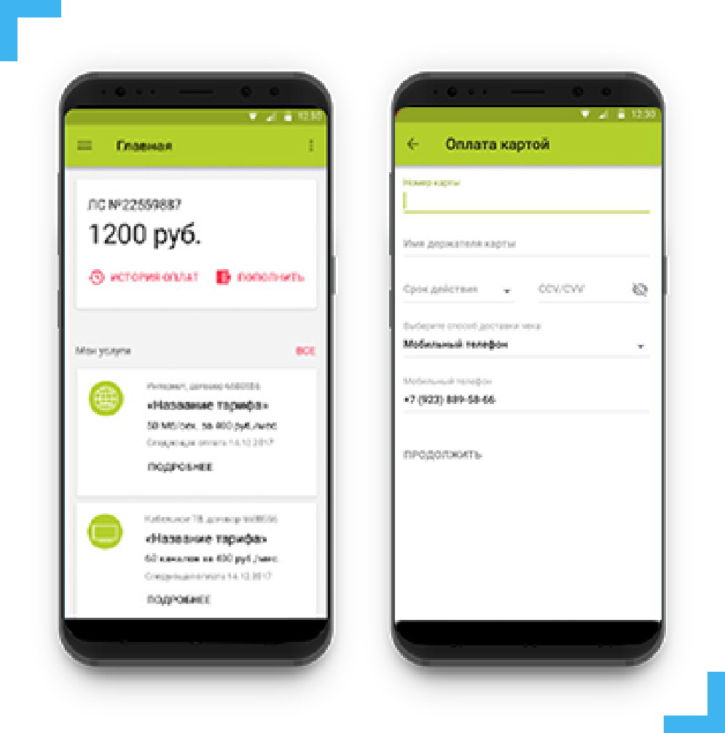
Client Account Manager App
Operator's online office on the subscriber's smartphone. Always available. Always near.
IT ALLOWS:
Reduce the number of technical support calls.
Change paid SMS to free PUSH notifications
Sell any services and equipment to your customers through a mobile app
Reduce accounts receivable
USE AS CONVENIENTLY:
One-time payment
Service model

Slide 11
Partners
COMPLETED PROJECTS:
200 000 subscribers
100 000 subscribers
500 000 subscribers
Organization and maintenance of a television service: integration with billing, development of applications, branding, implementation of adaptive broadcasting technology, Catch Up and VOD services. Development of service applications:client account manager app, voice console.
Organization and maintenance of an interactive television service based on Peers.TV OTT-service: Online broadcasting, Catch UP, VOD. Provision of content services: weather forecast, EPG, collections, recommender system. Development of mobile applications: voice control "Vladlink Console", personal account "Vladlink".
Development and support of a special WEB-widget that allows you to watch TV online and recorded through a WEB-browser for the Cosmos TV company, Minsk, Republic of Belarus. The solution is based on specialized server software Peers.TV, which allows organizing an OTT service with Catch UP functions.
OVER 50
REALIZED IMPLEMENTATIONS

Slide 12
ByteFog
Why BYTEFOG?
ByteFog — a technology that allows you to significantly reduce the cost of delivering video content to your users when organizing broadcasts of any scale. The development allows user devices to exchange content among themselves, thus effectively reducing traffic consumption from CDN.
System based on p2p technologies
СReduces traffic load by up to 60%
Supports: browsers, phones, tablets, set-top boxes and smart TVs
Has no restrictions with DRM
Low resource consumption on mobile devices (no more than 5%)

Slide 13
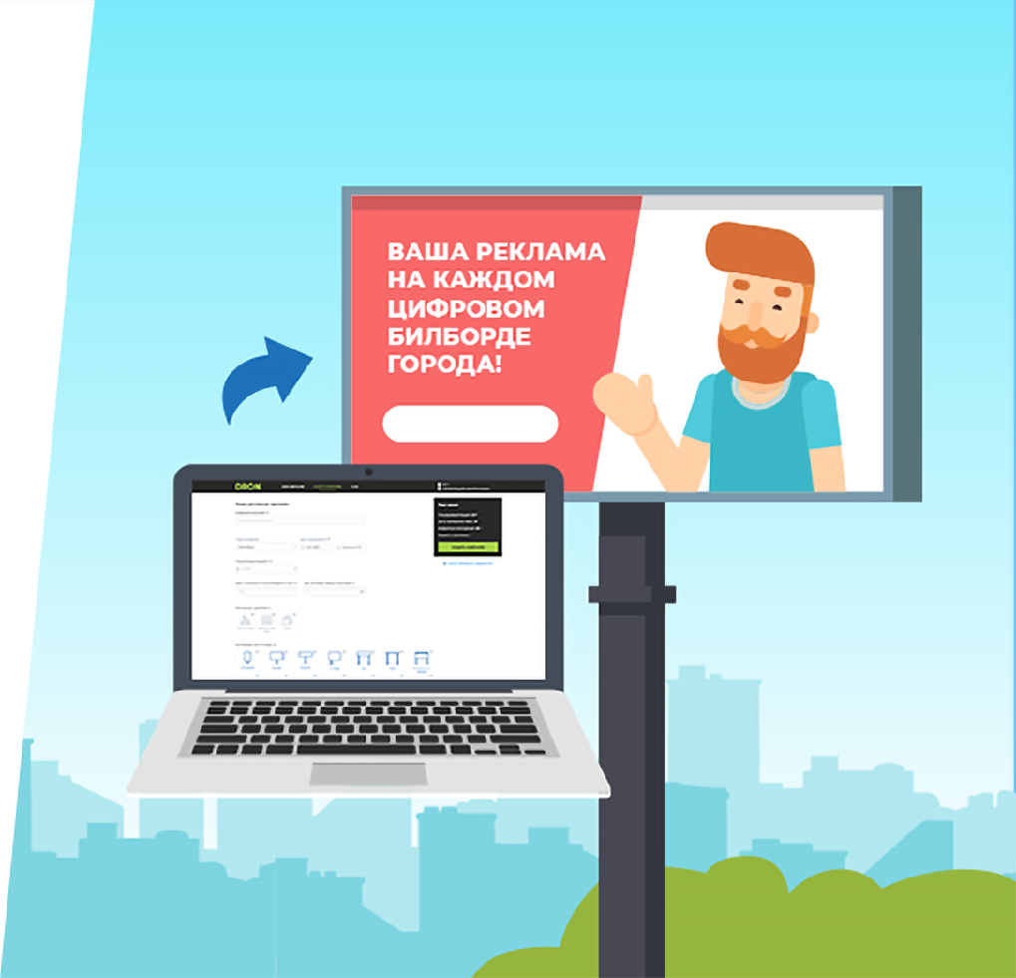
DRON
WHAT IS A DRON?
DRON — is a system for advertising on digital panels Outdoor and Indoor.
The advertiser pays for displaying advertising and information materials, which is carried out on digital panels connected to the system.
The cost of display in the system is not fixed, but is determined as a result of bidding between advertisers.
The maximum possible bid per impression is determined by Advertisers. The rates in the system can be applied both to a specific panel and to a group, but bidding occurs for each impression for each panel. Also, rates may vary by time of day.

Slide 14
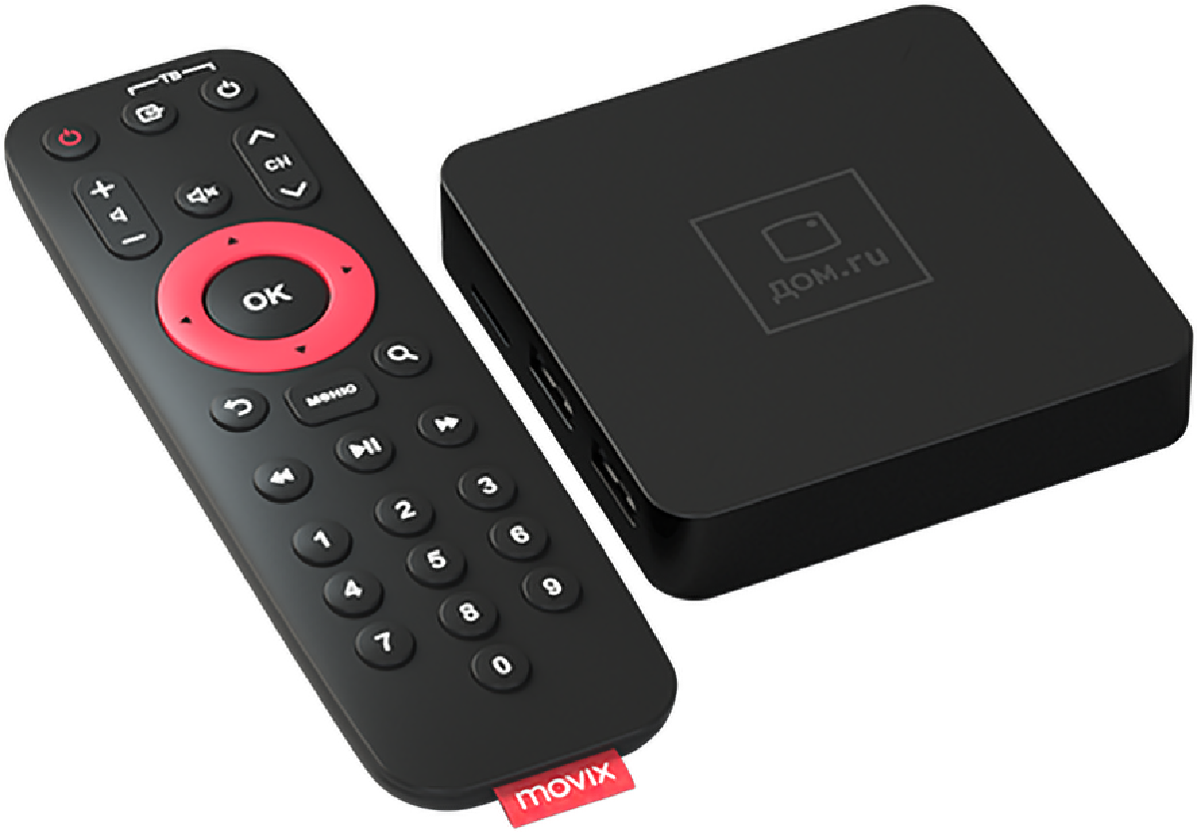
Movix Pro
WHAT IS MOVIX PRO?
MOVIX PRO — the flagship product of ER-Telecom (included in the TOP 5 telecom companies in Russia, Dom.ru brand).
It is part of the Movix ecosystem.
Android set-top box for which we have developed a launcher.

Slide 15
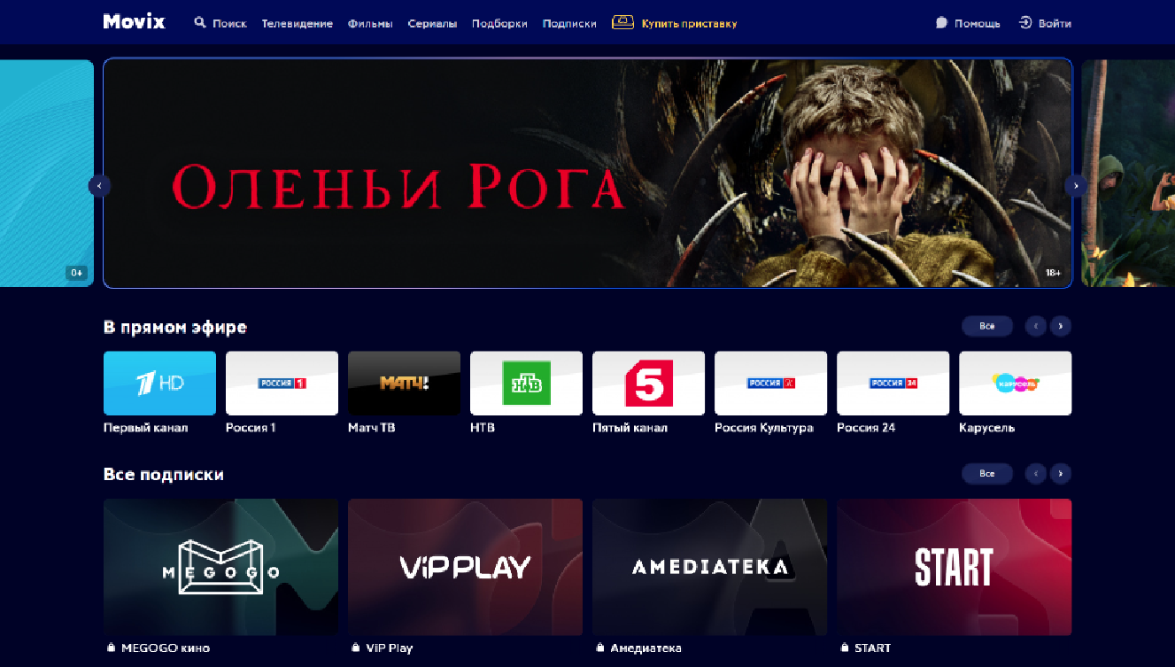
Web-site Movix.ru
MOVIX.RU AND MOVIX.PRO FEATURES:
Modern technologies in development
Support for all major broadcast formats (Multicast, HLS, DASH)
Android TV
4K content
Purchase, subscription and rental of content
Archive of programs
App Store
Recommendation system

Slide 16
"Smart" services
Our company was one of the teams in the development of such services as "My Accounts" and "My Home" for the Novosibirsk operator "Novotelecom"
MY HOUSE
MY BILLS
The application allows you to see all the necessary information about the state of the house, see who is ringing the intercom and open the door remotely.
A convenient service for paying utility bills, which allows you to make payments without leaving your home.
Video from intercom camera
Remote intercom control
Tranquility sensors: leaks, smoke, movement
Control outlets and lights from the app
Smart water meters and transmission of readings to a smartphone
Possibility of entering meter readings
Fast payment without leaving home
Reminders for entering readings and paying
Huge list of service providers

Slide 17
Contact us
Bochkov Evgeny
Chief Business Development officer
bochkoveo@inetra.ru
+ 7 923 187 5064
www.facebook.com/zhekb

